Slide 1
Data Independence in DBMS
9

Slide 2
Quiz
Which of the following provides the ability to query information from the database and insert tuples into, delete tuples from, and modify tuples in the database?
a) DML(Data Manipulation Language)
b) DDL(Data Definition Language)
c) Query
d) Relational Schema
A

Slide 3
Quiz
What do you mean by one to many relationships?
A) One class may have many teachers
B) One teacher can have many classes
C) Many classes may have many teachers
D) Many teachers may have many classes
B

Slide 4
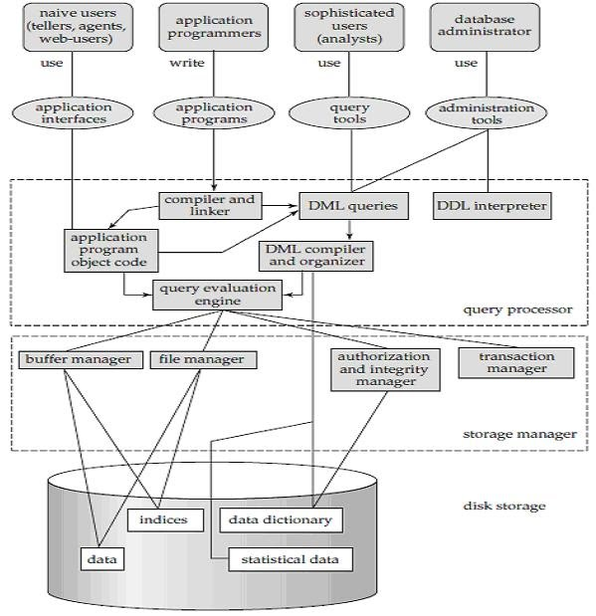
System structure of a database or Architecture of DBMS

Slide 5
Disk Storage
Starting from very beginning we know that the disk storage or the physical storage is use for storing the data. In many big enterprises, the database range in size from hundred of gigabytes to terabytes of data. The main memory is not so large that it holds that much information and data. So we need a larger disk storage for the database.
Components are as follows:
Data
Indices
Data Dictionary
Metadata
Statistical Data

Slide 6

Index
Indexing is used to optimize the performance of a database by minimizing the number of disk accesses required when a query is processed.
The index is a type of data structure. It is used to locate and access the data in a database table quickly.

Slide 7
Data Dictionary
A data dictionary is a file or a set of files that contains a database's metadata. The data dictionary contains records about other objects in the database, such as data ownership, data relationships to other objects, and other data. The data dictionary is a crucial component of any relational database. It provides additional information about relationships between different database tables, helps to organize data in a neat and easily searchable way, and prevents data redundancy issues. Ironically, because of its importance, it is invisible to most database users. Typically, only database administrators interact with the data dictionary.
In a relational database, the metadata in the data dictionary includes the following:
Names of all tables in the database and their owners.
Names of all indexes and the columns to which the tables in those indexes relate.
Constraints defined on tables, including primary keys, foreign-key relationships to other tables, and not-null constraints.
Additional physical information about the tables including their storage location, storage method, etc.

Slide 8
Data Dictionary
Attribute | Required | Format
SID | Yes | Text + Number
SNAME | Yes | Text
ADDRESS | No | Text
Mobile | Yes | Number
Email | No | Text + Number
Birth Date | Yes | Date
Age | Yes | Number
Constraints
Primary Key
NOT NULL
NOT NULL
NOT NULL
NOT NULL

Slide 9
Query Processor
The query processor components include:
DDL interpreter, which interprets DDL statements and records the definitions in the data dictionary.
DML compiler, which translates DML statements in a query language into an evaluation plan consisting of low-level instructions that the query evaluation engine understands.
A query can usually be translated into any of a number of alternative evaluation plans that all give the same result. The DML compiler also performs query optimization, that is, it picks the lowest cost evaluation plan from among the alternatives.
Query evaluation engine, which executes low-level instructions generated by the DML compiler.

Slide 10
Storage Manager
A storage manager is a program module that provides the interface between the low level data stored in the database and the application programs and queries submitted to the system. The storage manager is responsible for the interaction with the file manager. The raw data are stored on the disk using the file system, which is usually provided by a conventional operating system. The storage manager translates the various DML statements into low-level file-system commands. Thus, the storage manager is responsible for storing, retrieving, and updating data in the database.
The storage manager components include:
Authorization and integrity manager, which tests for the satisfaction of integrity constraints and checks the authority of users to access data.
Transaction manager, which ensures that the database remains in a consistent (correct) state despite system failures, and that concurrent transaction executions proceed without conflicting.
File manager, which manages the allocation of space on disk storage and the data structures used to represent information stored on disk.
Buffer manager, which is responsible for fetching data from disk storage into main memory, and deciding what data to cache in main memory. The buffer manager is a critical part of the database system, since it enables the database to handle data sizes that are much larger than the size of main memory.

Slide 11
Transaction Manager
A transaction is a collection of operations that performs a single logical function in a database application. Each transaction is a unit of both atomicity and consistency. Thus, we require that transactions do not violate any database-consistency constraints. That is, if the database was consistent when a transaction started, the database must be consistent when the transaction successfully terminates. Transaction - manager ensures that the database remains in a consistent (correct) state despite system failures (e.g., power failures and operating system crashes) and transaction failures.

Slide 12
Data View
A database system is a collection of interrelated files and a set of programs. A major purpose of a database system is to provide users with an abstract view of data means the system hide certain details of how data are stored and maintained. Hiding irrelevant details from user and providing abstract view of data to users, helps in easy and efficient user-database interaction.

Slide 13
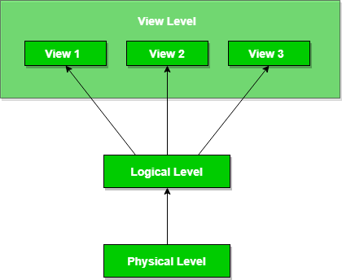
Data Abstraction in DBMS
Database systems are made-up of complex data structures. To ease the user interaction with database, the developers hide internal irrelevant details from users. This process of hiding irrelevant details from user is called data abstraction.

Slide 14
Data Abstraction in DBMS
We have three levels of abstraction:
Physical level: This is the lowest level of data abstraction. It describes how data is actually stored in database. You can get the complex data structure details at this level.
Logical level: This is the middle level of 3-level data abstraction architecture. It describes what data is stored in database.
View level: Highest level of data abstraction. This level describes the user interaction with database system.
Example: Let’s say we are storing customer information in a customer table. At physical level these records can be described as blocks of storage (bytes, gigabytes, terabytes etc.) in memory. These details are often hidden from the programmers.
At the logical level these records can be described as fields and attributes along with their data types, their relationship among each other can be logically implemented. The programmers generally work at this level because they are aware of such things about database systems.
At view level, user just interact with system with the help of GUI and enter the details at the screen, they are not aware of how the data is stored and what data is stored; such details are hidden from them.

Slide 15
Quiz
Which of the following refers to the level of data abstraction that describes exactly how the data actually stored?
A) Conceptual Level
B) Physical Level
C) File Level
D) Logical Level
B

Slide 16
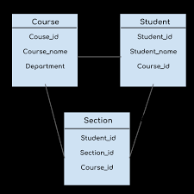
Schema
Overall design of a database is called the schema. Schema is of three types: Physical schema, logical schema and view schema.
The design of a database at physical level is called physical schema, how the data stored in blocks of storage is described at this level.
Design of database at logical level is called logical schema, programmers and database administrators work at this level, at this level data can be described as certain types of data records gets stored in data structures, however the internal details such as implementation of data structure is hidden at this level (available at physical level).
Design of database at view level is called view schema. This generally describes end user interaction with database systems.

Slide 17
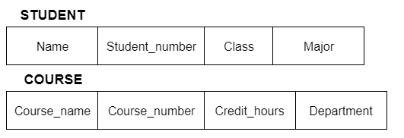
Schemas
Schemas:
Schema is the overall description of the database.
The basic structure of how the data will be stored in the database.
For Example:
type CUSTOMER=record
CUSTOMER_ID:integer
CUSTOMER_Name:String
CUSTOMER_ADD:String

Slide 18
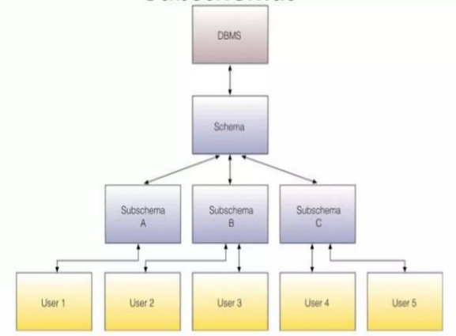
Sub Schemas:
Sub Schemas:
It is the subset of the schema and inherits the same property that a schema has.
It gives the users a window through which he/she can view only that part of the database which he want.

Slide 19
Instances
The data stored in database at a particular moment of time is called instance of database. Database schema defines the variable declarations in tables that belong to a particular database; the value of these variables at a moment of time is called the instance of that database.
For example, lets say we have a single table student in the database, today the table has 100 records, so today the instance of the database has 100 records. Lets say we are going to add another 100 records in this table by tomorrow so the instance of database tomorrow will have 200 records in table. In short, at a particular moment the data stored in database is called the instance, that changes over time when we add or delete data from the database.

Slide 20
Instances
Instances:
The collection of the data stored in the database at a particular moment is called an instance of a database.
For example:
Let’s say we have a single table student in the database, Today the table has 100 records, so today the instance of the database has 100 records.
Let’s say we are going to add another 100 records in this table by tomorrow so the instance of the database tomorrow will have 200 records in a table.

Slide 21
Schema Architecture
Schema Architecture:
The three-schema model consisting conceptual level, an external level, and internal or physical level was first introduced by Charles Bachman in 1975.
The motive of studying database architecture is to provide an abstract view.
Abstract view means that the system hides details on how the data is stored & and maintained in data base.

Slide 22
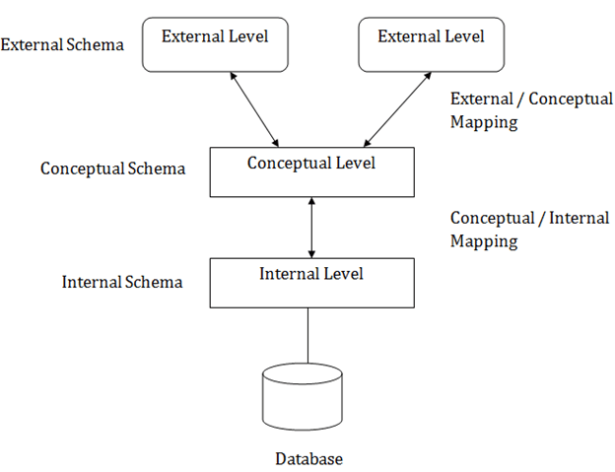
Schema Architecture
Schema Architecture:
The abstraction can be achieved by the help of 3-levels >
Internal (Physical) Level
Conceptual (Logical) Level
External (View) Level

Slide 23
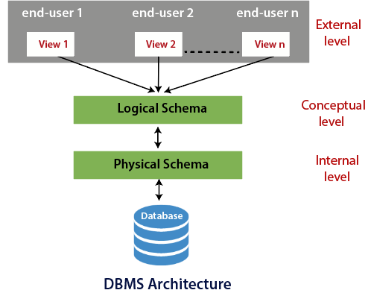
Three schema architecture

Slide 24
Three schema architecture
External level
It is also called view level. The reason this level is called “view” is because several users can view their desired data from this level which is internally fetched from database with the help of conceptual and internal level mapping.
Conceptual level
It is also called logical level. The whole design of the database such as relationship among data, schema of data etc. are described in this level. Database constraints and security are also implemented in this level of architecture. This level is maintained by DBA or the designer.
Internal level
This level is also known as physical level. This level describes how the data is actually stored in the storage devices. This level is also responsible for allocating space to the data. This is the lowest level of the architecture.

Slide 25
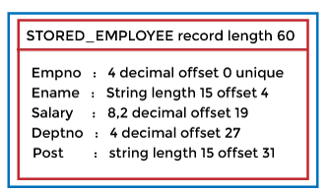
Internal (Physical) Level
Internal (Physical) Level:
The internal level has an internal schema that describes the physical storage structure of the database.
The internal schema is also known as a physical schema.
It gives complete details of data storage access paths, various record types, physical sequence of records etc.
This is the low-level representation of the entire database in detail.

Slide 26
Conceptual (Logical) Level
b) Conceptual (Logical) Level
The conceptual schema describes the design of a database at the conceptual level. The conceptual level is also known as the logical level.
The conceptual schema describes the structure of the whole database.
The conceptual level describes what data are to be stored in the database and also describes what relationship exists among those data.
In the conceptual level, internal details such as an implementation of the data structure are hidden.

Slide 27
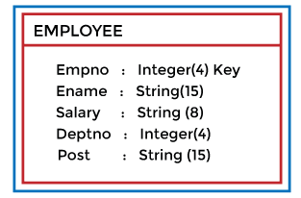
Conceptual (Logical) Level
b) Conceptual (Logical) Level
Programmers and database administrators work at this level.

Slide 28
External (View) Level
c) External (View) Level
The external level is concerned with individual users.
At the external level, a database contains several schemas that are sometimes called subschema. The subschema is used to describe the different views of the database.
An external schema is also known as a view schema.
Each view schema describes the database part that a particular user group is interested in and hides the remaining database from that user group.

Slide 29
Mapping
Different Mapping in Three Levels:
1) The Conceptual / Internal Mapping:
The Conceptual/ Internal Mapping lies between the conceptual level and the internal level.
It specifies how the data is retrieved from physical storage and shown at the conceptual level and vice-versa.
It also specifies how the conceptual record and field are represented at the internal level.

Slide 30
Different Mapping in Three Levels:
1) The External / Conceptual Mapping:
The External/Conceptual Mapping lies between the external level and the conceptual level.
Its role is to define the correspondence between a particular external and the conceptual view.
It also specifies how the data is retrieved from the conceptual level and shown at the external level because, at an external level, some part of the database is hidden from a particular user.

Slide 31
Contents
Data Independence
Physical data independence
Logical data independence

Slide 32
Data Independence
Data Independence is defined as a property of DBMS that helps you to change the Database schema at one level of a database system without requiring to change the schema at the next higher level. Data independence helps you to keep data separated from all programs that make use of it.
You can use this stored data for computing and presentation. In many systems, data independence is an essential function for components of the system.

Slide 33
Physical Data Independence
Physical data independence helps you to separate conceptual levels from the internal/physical levels. It allows you to provide a logical description of the database without the need to specify physical structures. Compared to Logical Independence, it is easy to achieve physical data independence.
With Physical independence, you can easily change the physical storage structures or devices with an effect on the conceptual schema. Any change done would be absorbed by the mapping between the conceptual and internal levels. Physical data independence is achieved by the presence of the internal level of the database and then the transformation from the conceptual level of the database to the internal level.

Slide 34
Physical Data Independence
Using a new storage device like Hard Drive or Magnetic Tapes
Modifying the file organization technique in the Database
Switching to different data structures.
Changing the access method.
Modifying indexes.
Changes to compression techniques or hashing algorithms.
Change of Location of Database from say C drive to D Drive.

Slide 35
Logical Data Independence
Logical Data Independence is the ability to change the conceptual scheme without changing
External views
External API or programs
Any change made will be absorbed by the mapping between external and conceptual levels.
When compared to Physical Data independence, it is challenging to achieve logical data independence.

Slide 36
Logical Data Independence
Due to Logical independence, any of the below change will not affect the external layer.
Add/Modify/Delete a new attribute, entity or relationship is possible without a rewrite of existing application programs
Merging two records into one
Breaking an existing record into two or more records

Slide 37
Difference between Physical and Logical Data Independence
Logica Data Independence | Physical Data Independence
Logical Data Independence is mainly concerned with the structure or changing the data definition. | Mainly concerned with the storage of the data.
It is difficult as the retrieving of data is mainly dependent on the logical structure of data. | It is easy to retrieve.
Compared to Logic Physical independence it is difficult to achieve logical data independence. | Compared to Logical Independence it is easy to achieve physical data independence.
You need to make changes in the Application program if new fields are added or deleted from the database. | A change in the physical level usually does not need change at the Application program level.
Modification at the logical levels is significant whenever the logical structures of the database are changed. | Modifications made at the internal levels may or may not be needed to improve the performance of the structure.
Concerned with conceptual schema | Concerned with internal schema
Example: Add/Modify/Delete a new attribute | Example: change in compression techniques, hashing algorithms, storage devices, etc

Slide 38
Importance of Data Independence
Helps you to improve the quality of the data
Database system maintenance becomes affordable
Enforcement of standards and improvement in database security
You don't need to alter data structure in application programs
Permit developers to focus on the general structure of the Database rather than worrying about the internal implementation
It allows you to improve state which is undamaged or undivided
Database incongruity is vastly reduced.
Easily make modifications in the physical level is needed to improve the performance of the system.

Slide 39
DBMS Architecture
Database management systems architecture will help us understand the components of database system and the relation among them.
The architecture of DBMS depends on the computer system on which it runs. For example, in a client-server DBMS architecture, the database systems at server machine can run several requests made by client machine.
There are three types of DBMS architecture:
Single tier architecture
Two tier architecture
Three tier architecture

Slide 40
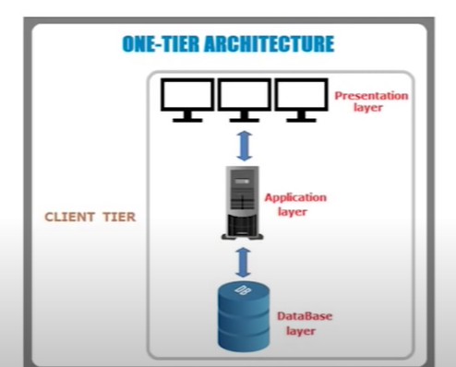
One tier architecture/ Client tier
In this type of architecture, the database is readily available on the client machine, any request made by client doesn’t require a network connection to perform the action on the database.
For example, lets say you want to fetch the records of employee from the database and the database is available on your computer system, so the request to fetch employee details will be done by your computer and the records will be fetched from the database by your computer as well. This type of system is generally referred as local database system.
The simplest of Database Architecture are 1 tier where the Client, Server, and Database all reside on the same machine. Anytime you install a DB in your system and access it to practice SQL queries it is 1 tier architecture. But such architecture is rarely used in production.

Slide 41
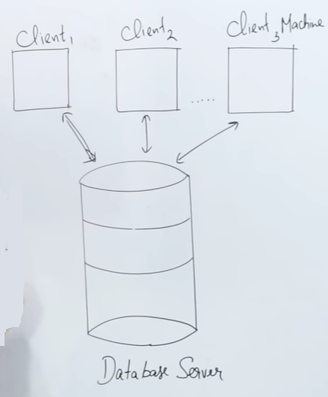
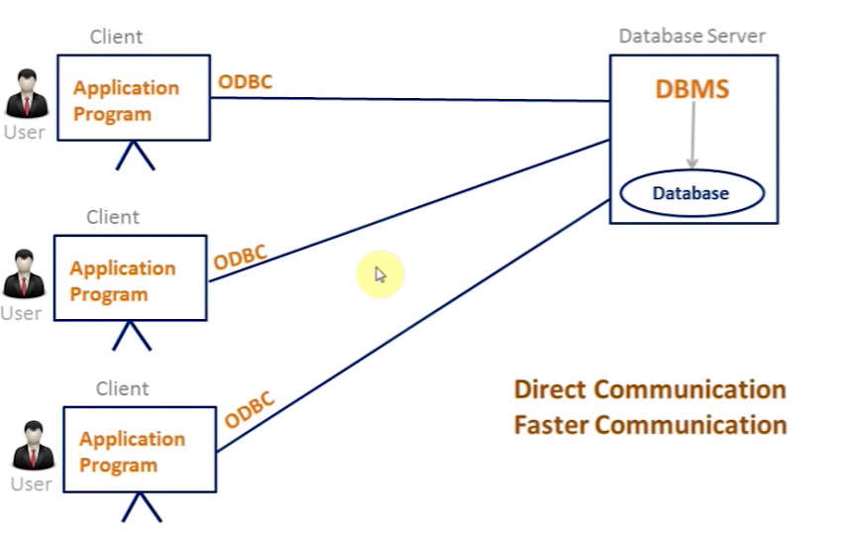
Two tier architecture
In two-tier architecture, the Database system is present at the server machine and the DBMS application is present at the client machine, these two machines are connected with each other through a reliable network as shown in the above diagram.
Whenever client machine makes a request to access the database present at server using a query language like SQL, the server perform the request on the database and returns the result back to the client. The application connection interface such as JDBC, ODBC are used for the interaction between server and client.

Slide 42
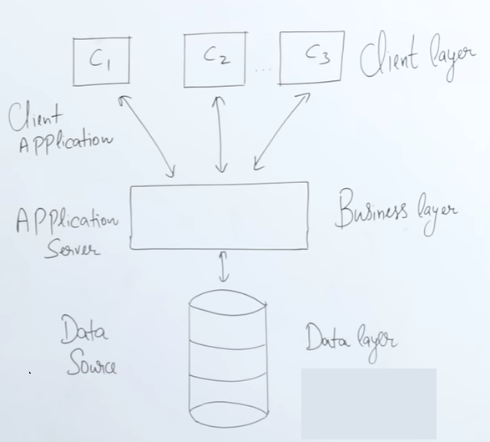
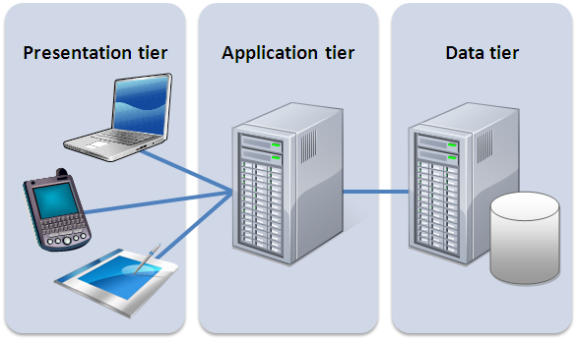
Three tier architecture
In three-tier architecture, another layer is present between the client machine and server machine. In this architecture, the client application doesn’t communicate directly with the database systems present at the server machine, rather the client application communicates with server application and the server application internally communicates with the database system present at the server.

Slide 43


